Slide 1
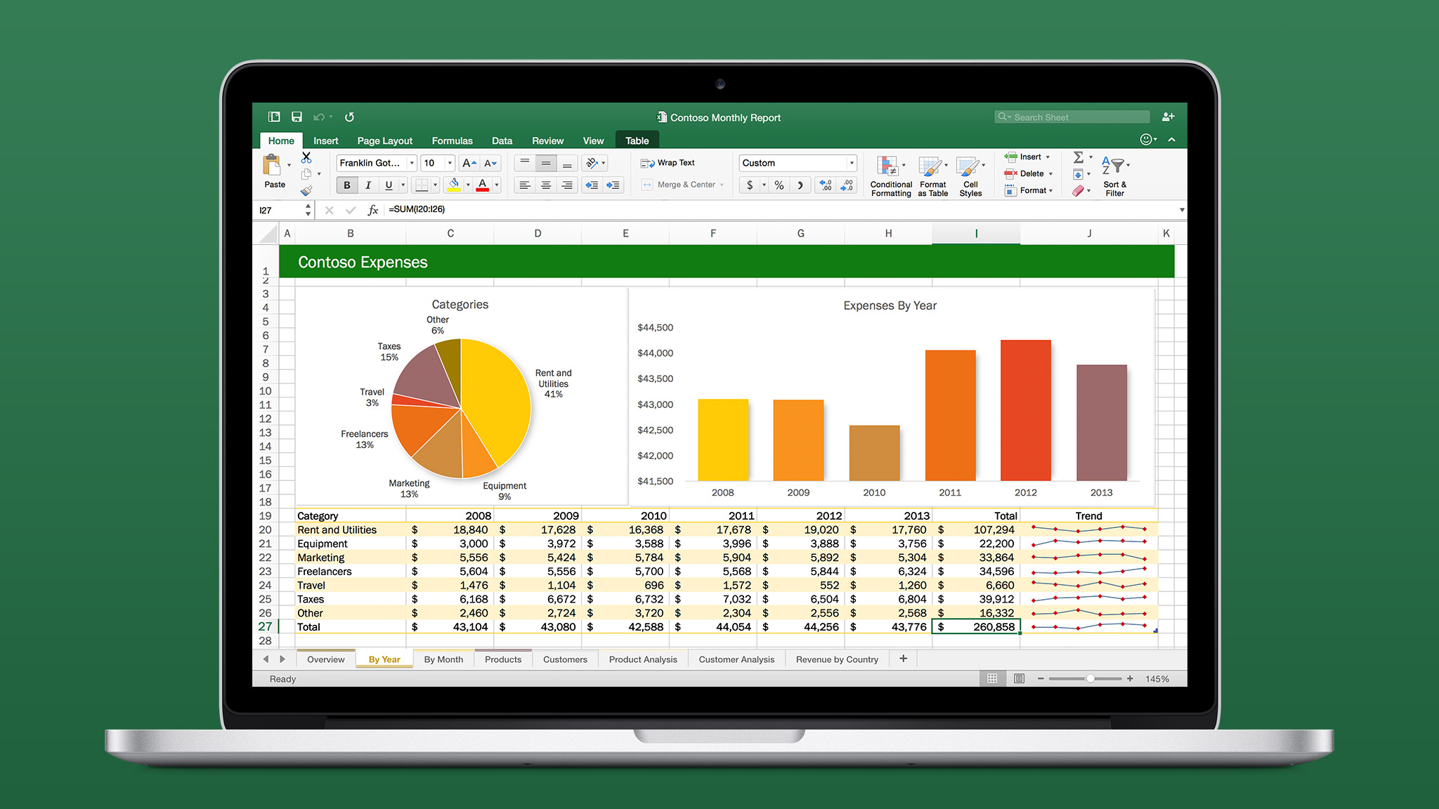
E-Commerce O-list Store Analysis
Project Team :- Group 6
Samadhan Adabal
Tanush Chilveri
Suraj Tayade
Pratik Girolkar
Ferdeen Shaikh
Kalpesh Bhosale

Slide 2
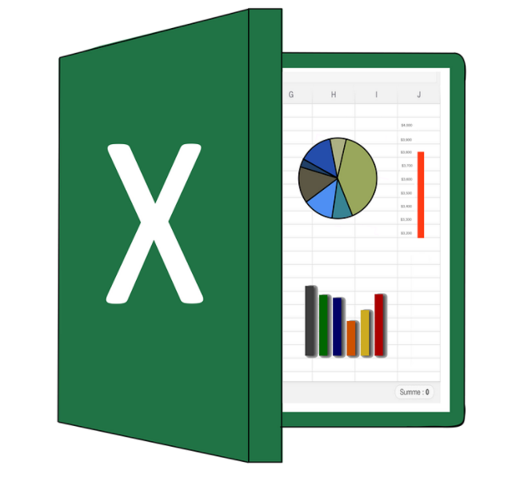

E-Commerce O-list Store Analysis
Introduction:
We are using Excel for Analysis Big Data set of E-commerce O-list Store Brazil.
Excel Providing Visual Representation.
It Is Enable for the ETL Process.
Forecasting and Predictive Analysis.
Microsoft Excel, a powerful and versatile data analysis tool.

Slide 3


E-Commerce O-list Store Analysis
Observation :
It is a Weekday Vs Weekend Payment Pie-chart.
Total Recover Payment in Weekday is 77% .
Total Recover payment in Weekend is 23%.
Weekend payment is Less as Compare to the Weekday payment
Suggestion:
Providing to the option for customers that they are take to the weekday payment in week.
Giving Some Offers in Weekend payment like a vouchers, Discount etc.

Slide 4
E-Commerce O-list Store Analysis
Observation :
Total Shipping days In Last Three years is 99441.
Total Review Score in Last Three years is 99224 Olist Store.
Suggestion:
Reduce time period in the products shipping days.
Shipping days is directly proportional to the review score because when delay shipping day for product so high chance customer can Canceling product.

Slide 5
E-Commerce O-list Store Analysis
Observation :
It Is a donut chart for Avg price & Quantity Sao Paulo City.
Average price of product price is 13%.
Average Quantity of Product is 87%
The Sao Paulo city product average Price is Less as compare to the all average Product Quantity.
Suggestion:
Decrease product Quantity in Sao Paulo City.
Maintaining the Product Quantity by Product Pricing in this Region.

Slide 6
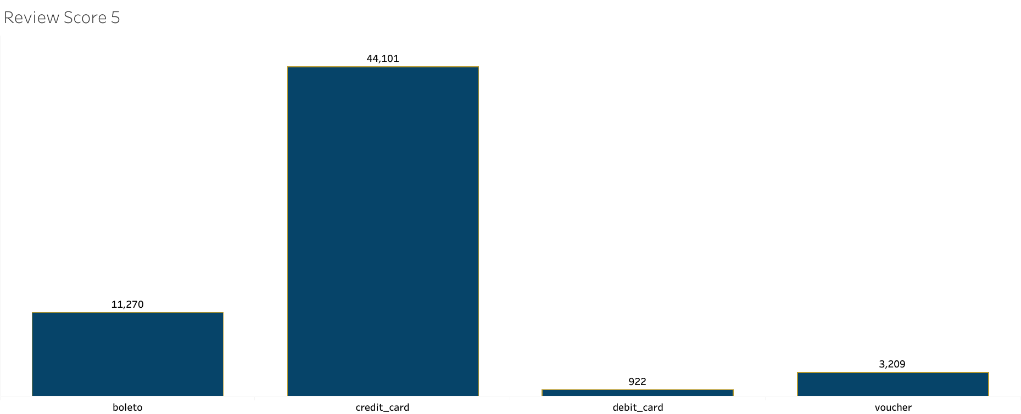
E-Commerce O-list Store Analysis
Observation :
It is a Histogram Chart 5 star review Score Rating.
Credit Card is a gaining Maximum 5 star Rating by Customer.
Boleto is 2 highest gaining the 5 Star Rating.
Debit Card is Lowest gaining the 5 star Rating in the Payment types.
Suggestion:
Provide new Type of Tools in debit Card payment type Option like takes some offers.
Adding some new Technology in debit Card payment field.

Slide 7

E-Commerce O-list Store Analysis

Slide 8
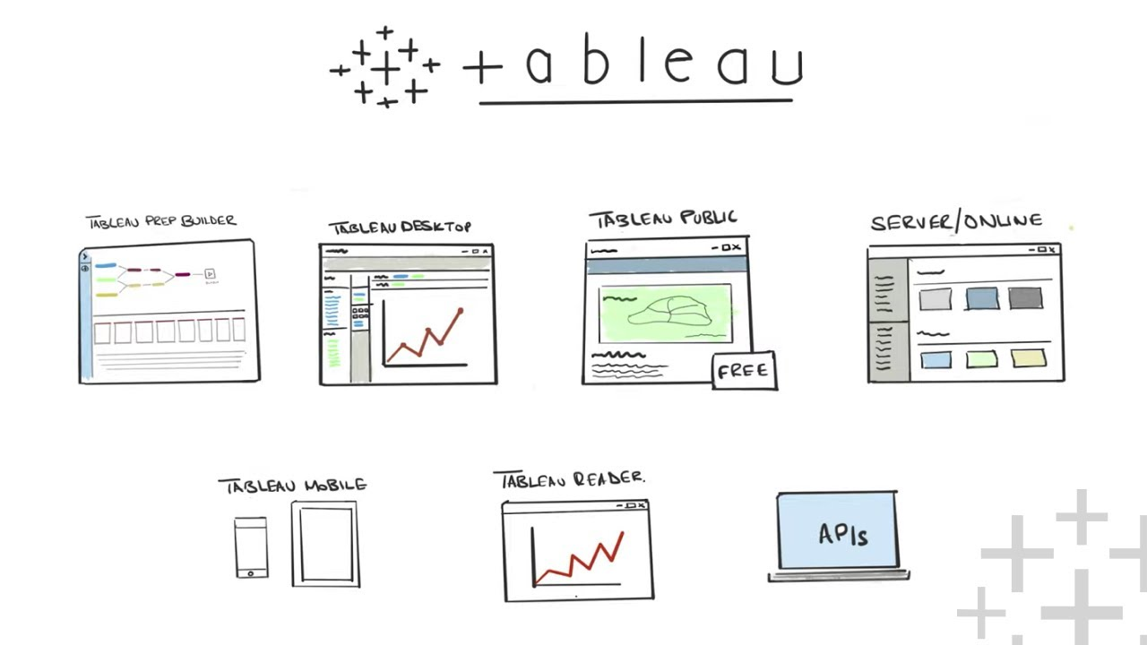
E-Commerce O-list Store Analysis
Introduction :
Visualizations in Tableau make it easier to understand the customer journey and make data-driven improvements to the user experience.
Tableau can help you analyze the customer journey from initial website visit to the final purchase.
​Tableau can be valuable. Tableau allows users to connect to various data sources, create interactive dashboards, and generate insightful reports and visualizations.
This Photo by Unknown Author is licensed under CC BY-NC-ND

Slide 9
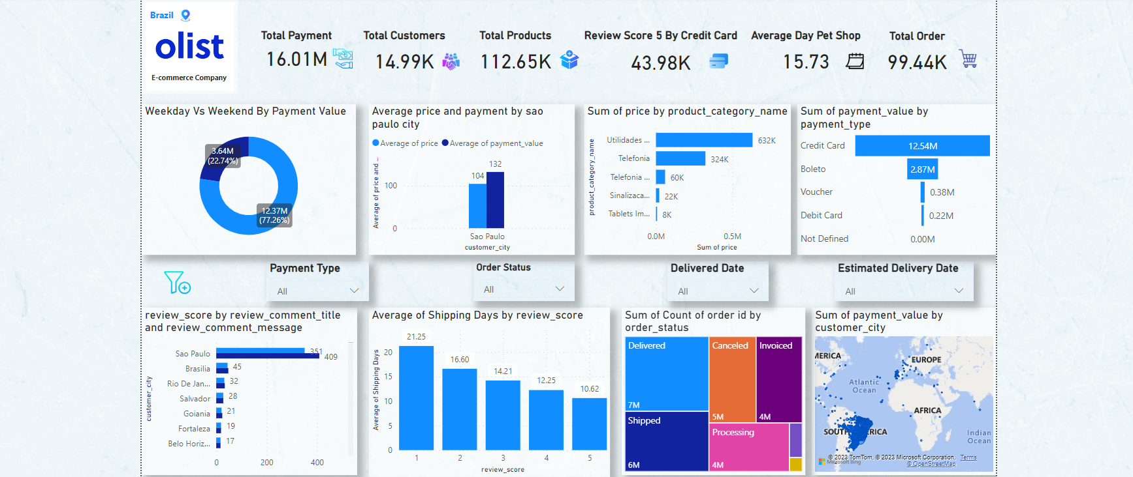
E-Commerce O-list Store Analysis Using tableau

Slide 10

E-Commerce O-list Store Analysis
Introduction:
Data Integration: Power BI enables you to connect to and integrate data from various sources,
including ​transactional databases, ​web analytics tools, and ​customer relationship management (CRM) systems.
combining all relevant data into a single data model, you can perform in-depth analysis and create meaningful visualizations.

Slide 11
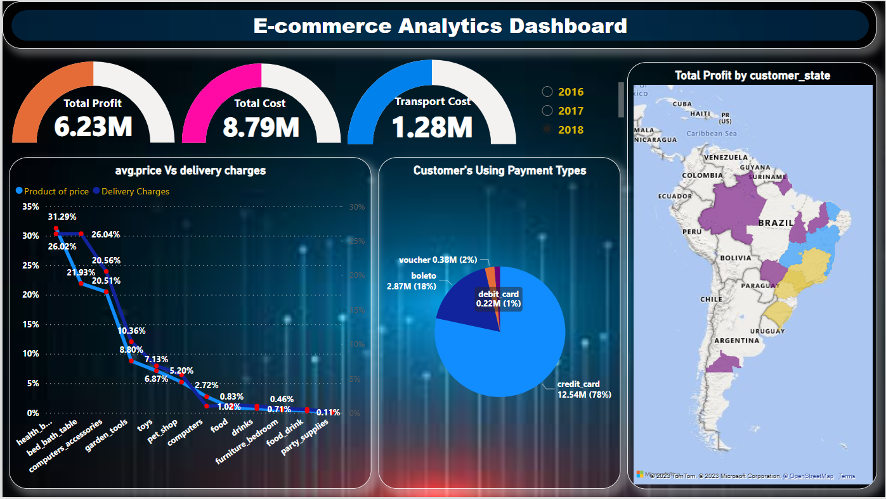
E-Commerce O-list Store Analysis Using Power-bi

Slide 12

E-Commerce O-list Store Analysis
Observation :
It is a E-commerce Analytics Dashboard Using Power-bi.
These are Three are Key Performance Indicator :
Total Profit In 2018 – 6.23 M.
Total Cost in 2018 – 8.79 M.
Transport Cost in 2018 – 1.28 M.
3) This is a Trend Line Chart For Product Of Price & Delivery Charges In 2018.
Bed bath table , garden tools.
these products Price is Less than as Compare to Delivery charges.
4) It is a pie-chart For Customers Using payment types :
Credit Card is Most Use payment type by Customers (78%).
Debit Card & Voucher is Very Less Use Payment type by Customers (1% &2%).
5) it is a filled Map for Total Profit by Customer State in Brazil :
Purple Color indicate Low Profit Customer State & Yellow Color indicate Medium Profit Customer State.

Slide 13
E-Commerce O-list Store Analysis
Suggestion :
Manage the product Cost & Built the Product in Low Cost.
Increase the Product Price in Bed Bath Table & Garden tools Related Product’s.
Promoting to the Debit Card & Voucher Payment type like a take to the discount in Debit card payment’s.
And also get to the take Discount in Voucher payment’s.

Slide 14

E-Commerce O-list Store Analysis
Challenge's Faced :
Data Mixing: Combining data from different sources was tricky.
Design Challenge: Keeping the look aesthetic and color combination across tools like Power BI, Tableau, and Excel was a challenge.
User Friendly: Getting everyone to understand and use the dashboards needed some effort.
Handling Outliers: Decision-making on whether to remove outliers or use robust statistical techniques is vital for accurate analysis.

Slide 15

E-Commerce O-list Store Analysis
Conclusion :
In conclusion, the analysis of raw Excel data led to the creation of comprehensive dashboards in Power BI, Tableau, and Excel.
These dashboards effectively present key performance indicators (KPIs) related to Weekday Vs Weekend Payment Statistics.
Number of Orders with review score 5 and payment type as credit card, Average number of days taken for order delivered customer date for pet shop.
Average price and payment values from customers of Sao Paulo city, Relationship between shipping days Vs review scores.
This data-driven approach enhances decision-making and provides valuable insights for strategic planning and optimization.

Slide 16

E-Commerce O-list Store Analysis
Introduction :
MYSQL is a popular open-source relational database management system (RDBMS) utilized in various industries.
It provides a scalable, reliable, and easy-to-use platform for storing and managing structured data.
MySQL is widely used in web applications and content management systems, making it an ideal choice for e-commerce platforms like O-list Store.

Slide 17
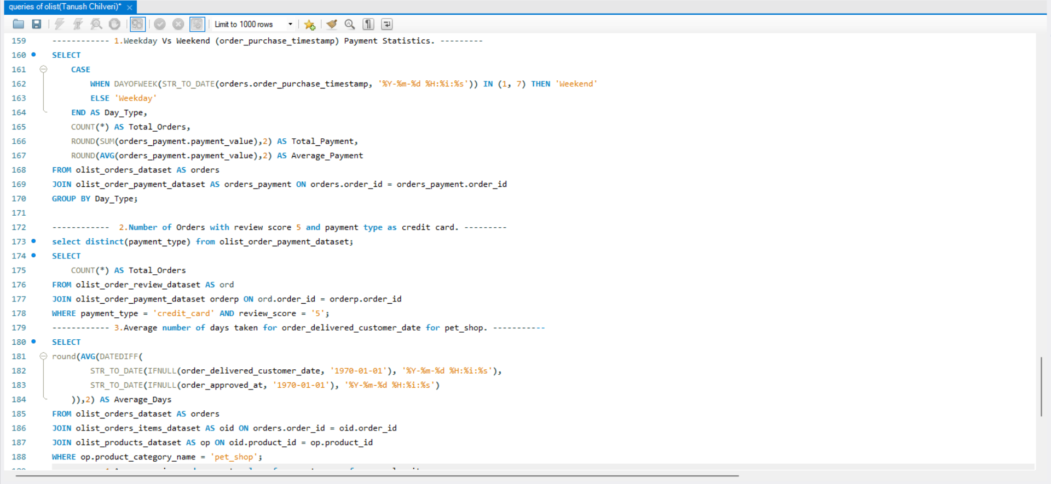
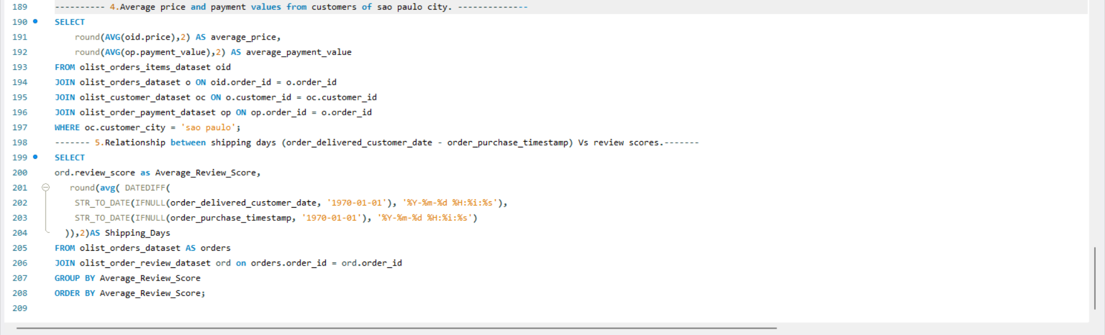
E-Commerce O-list Store Analysis

Slide 18

E-Commerce O-list Store Analysis

